Slide 1
Generating Synthetic Data Using LLMs
Comprehensive Workflow & Model Comparison

Slide 2
Ways to Use LLMs
1. Local Execution: Run downloaded models on your machine.
2. API-based: Access cloud-hosted models via REST APIs.

Slide 3
Local vs API — Performance Comparison
Local LLMs:
Slower, memory heavy, private
API LLMs:
Faster, scalable, dependent on internet

Slide 4
Research Task
Generate realistic synthetic data for database query testing.
Ensure data realism, schema integrity, and scalability to big data.

Slide 5
How LLMs Generate Synthetic Data
LLMs can generate structured data (CSV, JSON, SQL) when prompted properly.
Provide table schema, data types, ranges, and output format.
Example prompt:
Generate 50 rows of CSV data for a table 'employees':
- id: integer, unique
- name: realistic human names
- age: 20–60
- salary: 2500–6000
- department_id: 1–5
Output only CSV rows, no explanations.

Slide 6
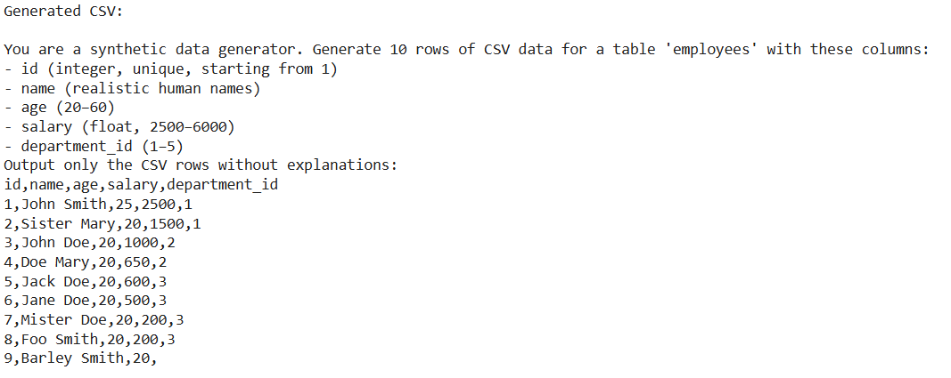
How LLMs Generate Synthetic Data
The discussed prompt generates the following data using gpt-neo-1.3B
Time taken to generate 10 lines: 4 minutes (in Google Colab)
Based on its token limit i.e. 2048, it can generate a maximum of 180-200 rows

Slide 7
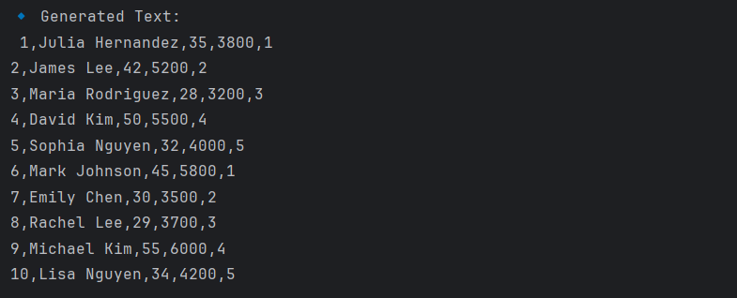
How LLMs Generate Synthetic Data
The discussed prompt generates the following data using zephyr-7b-beta
Time taken to generate 10 lines: less than a minute (in Pycharm)
Based on its token limit i.e. 8,192 tokens.

Slide 8
Scaling Up for Big Data
LLMs typically generate 50-100 rows per prompt.
For millions of rows:
• Use batch generation by looping LLM calls.
• Parallel execution to speed up.
• Combine data using pandas.
This needs to be tested.

Slide 9
Data Cleaning & Validation
Use pandas to:
• Load CSV files
• Check for duplicates, missing values, data types
• Validate primary & foreign keys

Slide 10
IDE Comparison for This Project
VS Code:
Lightweight, flexible for Python scripting and Jupyter notebooks.
Good for modular scripts, direct PostgreSQL integration.
Best if your local machine has enough RAM or GPU.
PyCharm:
Full Python IDE, great for code management.
Useful if working mostly with Python-only projects.
Not as lightweight as VS Code.

Slide 11
VS Code vs Colab for This Project
Colab:
Free GPUs (if needed), easy sharing.
Best for testing small datasets & quick prototyping.
Limited RAM for large models (like Mistral-7B) and also for future integration of data into postgresql, session expires.
VS Code (Local):
Full control, better for PostgreSQL integration & scripts.
Works if you have enough RAM/VRAM.

Slide 12
Questions/Discussion

